Slide 1
Design Modeling with UML: Design Sequence Diagram
Instructor: Mehroze Khan

Slide 2
Designing the Solution!
Introduction to Design Phase
Static vs. Dynamic Design Modelling
Interaction Diagrams
Design Class Diagrams

Slide 3
Modelling Dynamic Behavior
The UML includes interaction diagrams to illustrate how objects interact via messages.
They are used for dynamic object modeling.
Static OO design will be presented as Class Diagram.

Slide 4
Sequence Diagram
Sequence diagram simply depicts interaction between objects in a sequential order (i.e. the order in which these interactions take place.)
Sequence diagrams describe how and in what order the objects in a system function

Slide 5
Sequence Diagram
They illustrate how the different objects in a system interact with each other to carry out a function, and the order in which the interactions occur when a particular use case is executed

Slide 6
Interaction diagrams are used to visualize the interaction via messages between objects; they are used for dynamic object modeling.

Slide 7
Example of Sequence Diagram
:A
objB:B
one
two
three

Slide 8
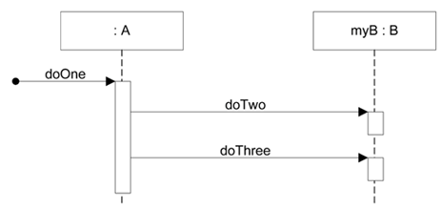
Sequence diagrams
Sequence diagrams illustrate interactions in a kind of fence format, in which each new object is added to the right
public class A
{
private B myB = new B();
public void doOne()
{
myB.doTwo();
myB.doThree();
}
// …
}
Notes:
Probably, that class A has a method named doOne and an attribute of type B. Also, that class B has methods named doTwo and doThree

Slide 9
Illustrating Classes and Instances
UML classes, instances and named instances
Notes:
* Differentiate bw Association and Link (Association is an indication of some relation BW static classes and no interaction; where a Link is a specific interaction BW objects).

Slide 10

Common Notations for UML Interaction Diagrams - Format for Interaction Messages
Interaction diagrams show messages between objects; the UML has a standard syntax for these message expressions
return = message(parameter:parameterType):returnType
Parentheses are usually excluded if there are no parameters. Type information may be excluded if unimportant.
initialize(code) initialize
d = getProductDescription (id)
d | = | getProductDescription | (id : | ItemId)
d | = | getProductDescription | (id : | ItemId) : | ProductDescription
The same syntax is used by, e.g., the Scala programming language.

Slide 11
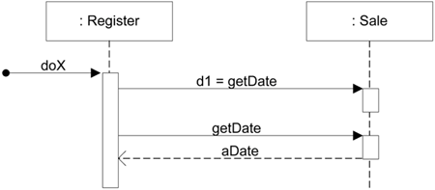
Two ways to show a return result from a message

Slide 12
Two ways to show a return result from a message

Slide 13


Two ways to show a return result from a message
:Register
:Sale
report
theReport = report
V a r i a n t A
:Register
:Sale
report
report
theReport
V a r i a n t B

Slide 14
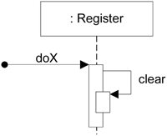
Messages to "self" or "this"
Messages to "self" or "this"
A message can be sent from an object to itself. This is illustrated by a link to itself, with messages flowing along the link.

Slide 15
Modeling (Synchronous) Messages
a message whose sender will not be specified
typical synchronous message shown with a filled-arrow
:Register
:Sale
report
getDate
Date
execution specification bar indicates focus of control
getSale

Slide 16
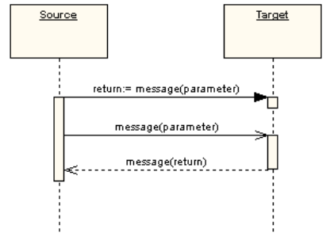
Synchronous and Asynchronous Messages
In the following diagram, the first message is a synchronous message (denoted by the solid arrowhead) complete with an implicit return message; the second message is asynchronous (denoted by line arrowhead), and the third is the asynchronous return message (denoted by the dashed line).

Slide 17
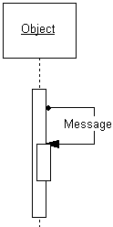
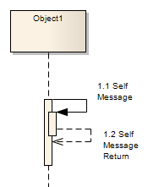
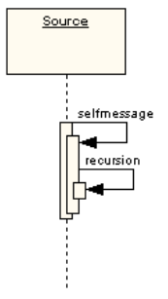
Self Messages
A self message can represent a recursive call of an operation, or one method calling another method belonging to the same object. It is shown as creating a nested focus of control in the lifeline’s execution occurrence.

Slide 18
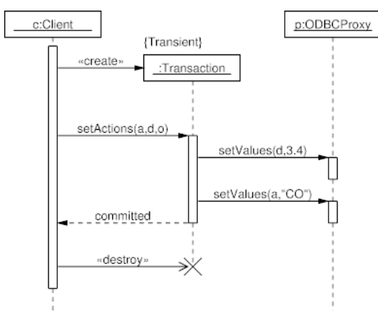
Create and Destroy Messages
Create messages are used to instantiate a new object
Delete/Destroy message is used to delete an object
Newly created objects are placed at their creation “height”.

Slide 19
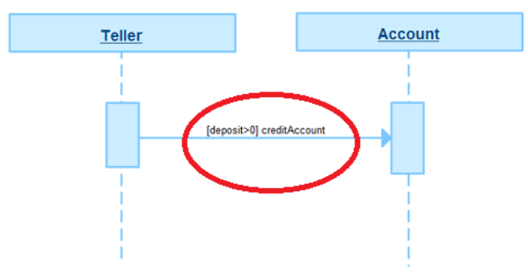
Guards
When modeling object interactions, there will be times when a condition must be met for a message to be sent to the object.
Guards are used throughout UML diagrams to control flow.

Slide 20
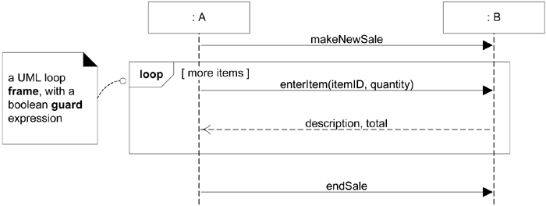
Diagram Frames in UML Sequence Diagrams
To support conditional and looping constructs (among many other things), the UML uses frames.
Frames are regions or fragments of the diagrams; they have an operator or label (such as loop) and a guard (conditional clause).

Slide 21
Frame Operator
Frame Operator | Meaning
alt | Alternative fragment for mutual exclusion conditional logic expressed in the guards.
loop | Loop fragment while guard is true. Can also write loop(n) to indicate looping n times. There is discussion that the specification will be enhanced to define a FOR loop, such as loop (i, 1, 10)
opt | Optional fragment that executes if guard is true.
par | Parallel fragments that execute in parallel.

Slide 22
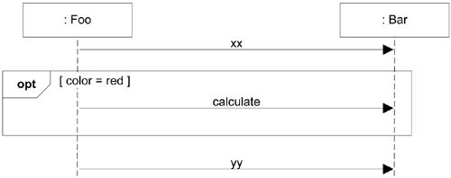
Conditional Messages
An OPT frame is placed around one or more messages.
Notice that the guard is placed over the related lifeline

Slide 23
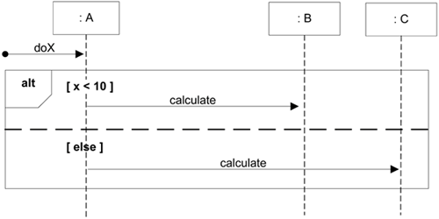
Mutually Exclusive Conditional Messages
An ALT frame is placed around the mutually exclusive alternatives

Slide 24
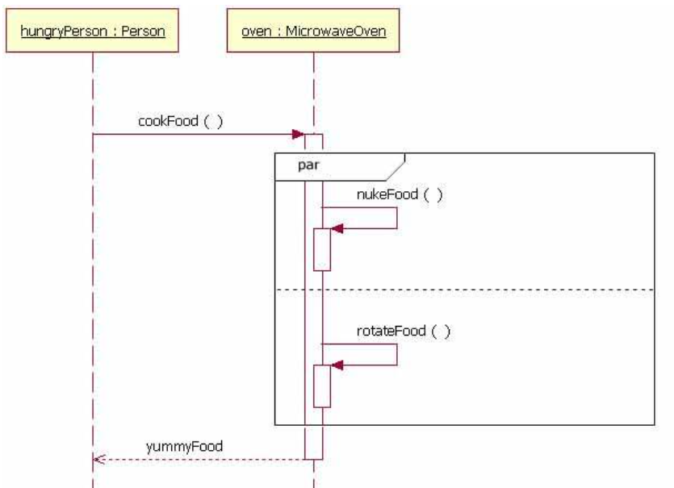
Parallel Frame
When the processing time required to complete portions of a complex task is longer than desired, some systems handle parts of the processing in parallel.
The parallel combination fragment element needs to be used when creating a sequence diagram that shows parallel processing activities.

Slide 25
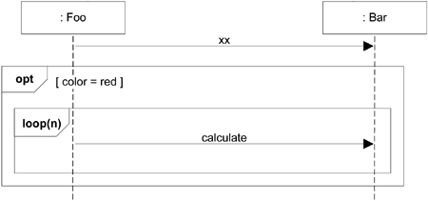
Nesting of Frames
Frames can be nested

Slide 26


Use a UML loop frame to iterate over a collection.
:Sale
lineItems[i] : SalesLineItem
t = getTotal
loop
[for each sales line item]
st = getSubTotal
Modeling task: Calculate the total of a sale by summing up the sub totals for each sales line item.

Slide 27

How to model the sending of a message only if a guard condition matches?
Modeling task: Get the sum of all sales that happened today after 18:00 o’clock.

Slide 28


Use a UML opt frame to model the sending of a message if the guard condition matches.
:Register
sales[i] : Sale
r = getTotal(startDate)
loop
[for each sale]
date = getDate
opt
[startDate < date]
t = getTotal
Frames can be nested.

Slide 29
How to model mutually exclusive alternatives?
Modeling task: A register should be able to handle credit card payments and cash payments.

Slide 30

Use the UML alt frame to model between two and n mutually exclusive alternatives.
:Register
makePayment(type,sale)
alt
[type = CreditCardPayment]
create
:CreditCardPayment
[type = CashPayment]
create
:CashPayment

Slide 31
References
Larman, Craig. Applying UML and patterns: an introduction to object oriented analysis and design and interative development. Pearson Education India, 2012.
Object-Oriented Analysis and Design with Applications, Grady Booch et al., 3rd Edition, Pearson, 2007.
Timothy C. Lethbridge, Robert Laganaiere, Object-Oriented Software Engineering (2nd Edition), McGraw Hill, 2005
Object-Oriented Modeling and Design with UML, Michael R. Blaha and James R. Rumbaugh, 2nd Edition, Pearson, 2005.

